Slide 1

Zeroth Presentation of Project on
“ROBOTIC ARM WITH MACHINE LEARNING CAPABILITIES”
Presented by
Roll No. 29 MOHAMMED SINAN M
Roll No. 31 MUHAMMED AJMAL ROSHAN
Roll No. 33 MUJEEB RAHMAN M P
Roll No. 68 MOHAMMED HASEEB K P
under the guidance of
Prof. SHARANYA V P
DEPARTMENT OF ELECTRICAL & ELECTRONICS
ENGINEERING
GOVT. COLLEGE OF ENGINEERING KANNUR- 670563
Oct 2021

Slide 2
OVERVIEW
Introduction
Literature Review
Objective
Model
Plan of Excecution
Parts / Technologies
Reference
<number>

Slide 3
INTRODUCTION
A robotic arm with machine learning capabilities by which it sense its environment and perform tasks by taking instruction from the admin.
To upgrade and develop the existing model which is in present industrial application by adding software and associated features using Raspberry Pi
Can be used for wide variety of applications in both domestic and industrial automated applications.
<number>

Slide 4
LITERATURE REVIEW
Modeling and Analysis of a 6 DOF Robotic Arm (Canadian Journal on Electrical and Electronics Engineering Vol. 3, No. 6, July 2012):
The kinematics of a robotic arm deals with the study of the geometric and time based properties of the motion and in particular how various links of a robot move with respect to one another and with time.
Machine Learning with Robotics(Thomas P. Trappenberg Dalhousie University, CSCI 4155/6505)
Aim of learning machines from the environment, either through instructions, by reward or punishment, or just by exploring the environment and learning about typical objects or spatio-temporal relations.

Slide 5
OBJECTIVE
Our project is to create a device that can understand visual and audio inputs or simply a device that can understand its enviroment.
We plan to create an arm that can find and learn things from its surroundings and do simple tasks like finding and picking object that user asked.
5

Slide 6
WORKING
First the R.A learns the object with the help of user by showing it to the camera.
Then the R.A saves the users face who gave request to find the object
R.A searchs the room for the object
R.A picks the object and takes it back to user who gave the request
If there are same objects in multiple color and shape, the robot picks the exact same object shown by the requested user.
6

Slide 7
WORKING
The recoginition process takes place only once , the face and object will be saved in its memory for future reference.
The R.A only picks the object within its vision, so there wont be any advanced searching method.
7

Slide 8
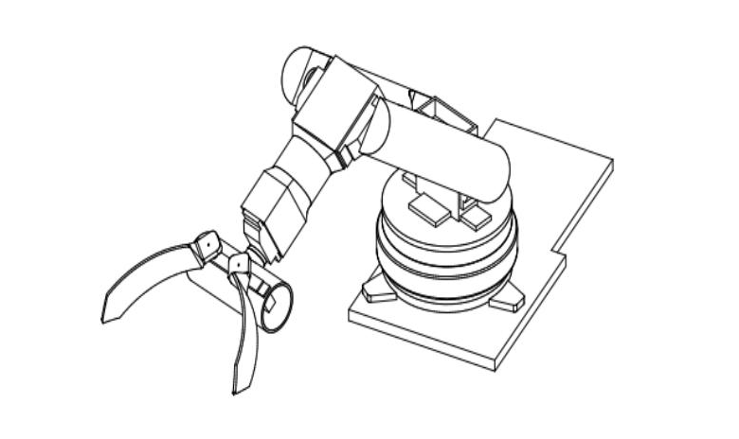
MODEL
7

Slide 9
MODEL
We are planning to make a robotic arm with 5/6 degree of freedom which means :
Axis 1 - Rotates robot (at the base of the robotic arm)
Axis 2 - Forward / back extension of robot's lower arm
Axis 3 - Raises / lowers robot's upper arm
Axis 4 - Rotates robot's upper arm
Axis 5 - Raises / lowers wrist of robot's arm
Axis 6 - Rotates wrist of the robot's arm
(not finalized yet)
9

Slide 10
PLAN OF EXCECUTION
PHASE 1 :
Designing : Body structure designing using Autodesk 3ds Max.
Fabrication : Fabricate the design using 3d printer
Assembling : Creating the hardware model by assembling parts with the printed body
Controlling : In phase 1, The robotic arm is controlled through a remote thus ensures the working of the hardware, the microcontrolled used will be Rasberry Pi
10

Slide 11
PLAN OF EXCECUTION
PHASE 2:
Software : In this phase, 1 or 2 cameras are connected to the Rasberry Pi for sensing the enviroment(ultrasonic sensors will also be connected). Then the source code will be altered to give the robotic arm the ability to identify faces and objects in its surroundings
Rasberry Pi will be loaded with Raspbian( OS ) which will be used to program or automate the robotic arm by giving machine learning capabilities.
11

Slide 12
PARTS / TECHNOLOGIES
RASBERRY PI : Here the Rasberry Pi is used as the brain of the robotic arm. As it is a mini pocket sized computer it is very much hackable and its specifications are very much suited for the task.
SERVO MOTOR : A servomotor is a linear actuator or rotary actuator that allows for precise control of linear or angular position, acceleration, and velocity.
CAMERA MODULE : Camera module is used to give a visual input to the rasberry pi.
ULTRASONIC SENSOR : An ultrasonic sensor is an electronic device that measures the distance of a target object by emitting ultrasonic.
12

Slide 13
PARTS / TECHNOLOGIES
OPEN SOURCE COMPUTER VISION (OpenCV) : Is an open source computer vision and machine learning library which provides a common infrastructure for computer vision applications
RASPBIAN : Is Rasberry Pi’s offfical OS based on debian (linux) for the Rasberry Pi hardware. It comes with over 35,000 packages optimized for best performance on the Rasberry Pi.
13

Slide 14
REFERENCE
Mark S., Seth H. and Vidyasagar M., "Robot modeling and control", John Wiley & Sons, 2006.
Clothier K.E. and Shang Y, “A geometric approach for robotic arm kinematics with hardware design, electrical design and implementation”, Journal of Robotics, Article ID 984823, Vol. 2010.
C.-Y. Tsai, C.-C. Wong, C.-J. Yu, C.-C. Liu, and T.-Y. Liu, “A hybrid switched reactive-based visual servo control of 5-dof robot manipulators for pick-and-place tasks,” IEEE Systems Journal, vol. 9, no. 1, pp. 119–130, 2015.
14

